Slide 1


Research Paper
B. Boothe (Computer Science Department, University of Southern Maine) Using Real Execution Timings to Enliven a Data Structures Course, Frontiers in Education: Computer Science (FECS), 2012.
Abstract: Which is faster, an array list or a linked list? In our data structures course we increase the engagement of our students by asking them to predict the outcome of a future race between competing data structures. We record their predictions for future validation, and subsequently as we analyze the data structures, students are more engaged in the analysis because it either lends credence or doubt towards the accuracy of their predictions. Some of their expectations get radically broken by the analysis, and in the end everyone gets surprised by the actual runtime results. Everyone benefits because the class is more engaging and the results are more memorable.
zero
citations

Slide 2
The Race
Our students know that array lists have to periodically grow the internal array by creating a new one and copying everything over, and they know that it is painfully slow to insert at the start of an array list and move everything up. They have also been convinced linked lists are slick because of how efficiently they can insert new values between others without needing to copy anything.
Take n random integers and insert them into the data structure while maintaining the data structure in sorted order at every insert. After each insert, search for some random integer.
Make predictions on which will be faster, array lists or linked lists, running on a real computer.

Slide 3
Student Predictions
The majority of groups always predict that linked lists will be either a little faster or a lot faster than array lists. For justifications they cite the high cost of inserting into the array and the cost of repeatedly growing the array to make it larger. In contrast, usually at least one group notes that the sorted array can be binary searched much faster than the linear search required of the linked list, and thus they predict that the array list will be faster. Finally, there is usually another group that remembers and utilizes asymptotic analysis…
int binarySearch(int *a, int lo, int hi, int data) {
if(lo > hi) { return -1; } // not found
int mid = (lo + hi)/2;
if(a[mid] < data)
return binarySearch(a, mid+1, hi, data);
if(a[mid] > data)
return binarySearch(a, lo, mid-1, data);
return mid;
}
Initially: lo = 0, hi = n-1
O(log n)

Slide 4
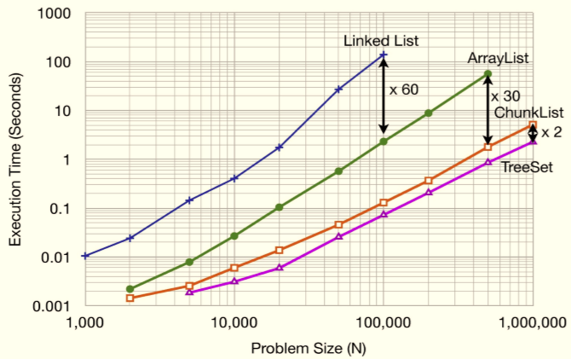
Asymptotic analysis
Repeat n times:
insert item into list in sorted order
search for some item
Thus, the asymptotic analysis for both is O(n²)
Real execution time from a 2.4 GHz Intel Core 2 Duo with a 2MB L2 cache and 3.25 GB of RAM running Java 6
ArrayList | LinkedList
O(n)
O(log n)
O(n)
O(n)
Note: log-log plot

Slide 5
Why 60x slower??
Focus on the expensive operations:
ArrayList: move items in memory n calls to System.arraycopy()
LinkedList: iterate and compare n² calls to comparator/next
Memory:
ArrayList uses 3 times less memory than LinkedList (for the Java implementation)
More data is in the L1 cache, so faster performance
Bottom line: If asymptotic complexities of two approaches are the same, then real execution times do matter!

Slide 6
Stacks
A stack is a data structure that supports inserting and deleting data, with a special property
The LIFO property: the Last item In is the First item Out
Example: Activation records
Insert: push onto the stack
Delete: pop from the stack
Signature for pop: Stack pop(Stack s, int *data);
Additional operations:
Is the stack empty?
If not, what is the top item in the stack (peek)

Slide 7
Stack Implementation
With ArrayList2 implementation:
push as append O(1) time usually, O(n) time worst case
pop as deleteLast O(1) time
isEmpty?
peek?
With LinkedList1 implementation:
push as prepend O(1) time
pop as deleteFirst O(1) time
isEmpty?
peek?

Slide 8
Queues
A queue is a data structure that supports inserting and deleting data, with a special property
The FIFO property: the First item In is the First item Out
Example: A queue of customers
Insert: enqueue
Delete: dequeue
Additional operations:
Is the queue empty?
Concatenate two queues
Question: Can each of these operations be implemented in O(1) time using any one of our list data structures?

